Slide 1
FINANCE INDUSTRY [CRED]
The most rewarding credit card payments app ever
ANIRUDH PANDA - 190610193

Slide 2
2. Target Audience
CRED targets the top 15-20 million credit card spenders or “premium consumers” and lets users with high credit scores pay multiple credit card bills while offering them exciting rewards.

Slide 3
3. Age group
CRED targets millennials and specially people in the age of 25-40 because The CRED app only accepts users who have a credit score above 750. The app checks your credit score through your phone number which is connected to your bank account. If you do not qualify for entry into the app, you are put on a waitlist.

Slide 4
4. DEMOGRAPHICS
The first–open post-installation of CRED is at 50% which isn’t unusual. They retain 20-25% of users who do a first-open. This is quite good considering those with a credit score below 750 don’t have access.
Credit cards issued has grown at a CAGR of 20% over the last 5 years and is expected to grow by up to 25% in subsequent years

Slide 5
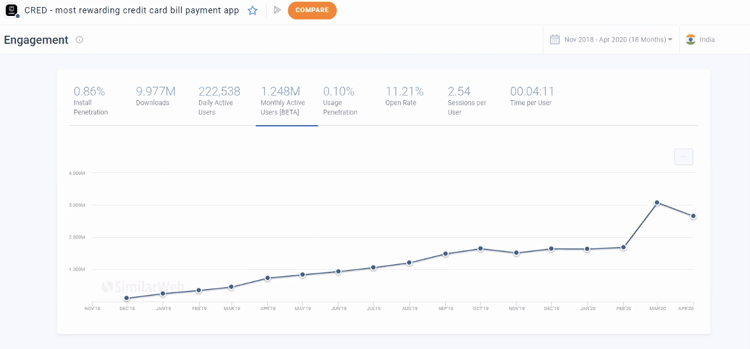

Slide 6
App Insights
71% are between 25-34 years.
CRED made good use of March to drive downloads :). Most advertisers stopped spending which resulted in a lower competition which in turn resulted in a drop in Ad costs. Spotting the opportunity, they likely increased spends and got downloads at a 30-50% discount compared with the other months

Slide 7
CRED entered the unicorn club with its latest series D funding of 215 Million dollars, taking its valuation to 2.2 Billion dollars.

Slide 8
5. Objective of the industry
The CRED App aims to make using your credit cards easier and automated. The app also offers many rewards for using in the form of CRED coins, which can be redeemed for cash or offers.

Slide 9
6. Approach in terms of campaign.
For Cred, they have leveraged yesteryears’ stars and their nostalgic appeal, using them in cheeky and surprising ways.
I believe CRED has one of the best marketing and content writing team out there.
The only thing i would have loved is making a product for teenagers or those who do not have their credit card yet like FamPay. CRED is missing out the younsters for the same.

Slide 10


CRED’s IPL CAMPAIGN YIELDED 6-7x INCREASE IN THEIR DAILY SIGN-UPS.

